Slide 1
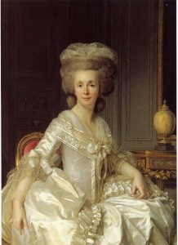
The Role of Women in
18th Century French Salons
By Griffin Godsick
AP Euro
March 2014
Renowned salonnière
Madame Necker (Suzanne Curchod)

Slide 2
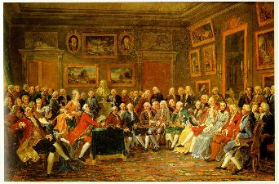
What is a Salon?
A conversational gathering. Usually this is a select group of intellectuals, artists and politicians who meet in the private residence of a socially influential and often wealthy person. Numerous wealthy women presided over salons in France throughout the 17th and 18th centuries.
For a more detailed definition of a salon,
visit this link: http://www.bdavetian.com/salonhistory.html
A Reading in the Salon of Madame Geoffrin in 1755
painted by Anicet-Charles-Gabriel Lemonnier

Slide 3
The Beginning of Salons
Started in the early 16th century, and debatably still present, though the generally accepted cut-off is early 19th century.
The first salon was considered to have begun around 1607 in the Parisian townhouse of Catherine de Vivonne, marquise de Rambouillet, where she received guests in her famous chambre bleue (Blue Room)
*To learn more about Madame Rambouillet, visit this link:http://www.dailywriting.net/SalonBackground.htm
Salons began to flourish in France during the period known as the Enlightenment, which spanned the 18th century.
*To read more about the Enlightenment, click on this link: http://plato.stanford.edu/entries/enlightenment/

Slide 4
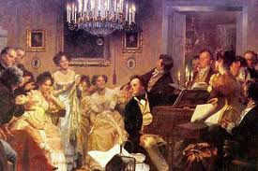
Women’s Roles in the Salons
Much of the growing attendance and importance of salons was a direct result of the women hosting these intellectual gatherings. At the salons, the salonnière chose her guests and thereby determined the ultimate composition of the room. While men could decide whether or not they attended a salon, it was the salonnière who determined whether they would be invited at all.
*To learn more about the women of the French salons,
visit this link: http://www.youtube.com/watch?v=SbRGIFIBcQk

Slide 5
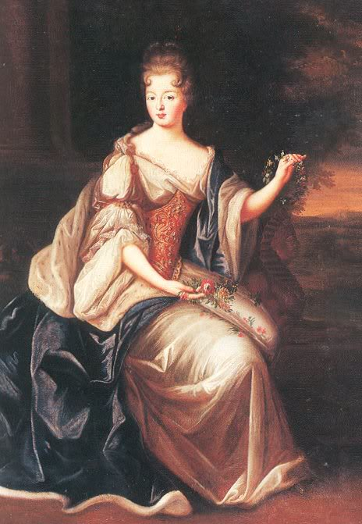
Important Women of the Salons
Women, known as salonnières, were at the center of the salons, which allowed them leadership and involvement in an intellectual capacity like no other venue in society.
Some of the most famous salonnières included:
MADAME NECKER
MADAME DE STAEL
MADAME GEOFFRIN
MADAME DU DEFFAND
MADAME D'EPINAY
MADAME DE TENCIN
MADEMOISELLE DE LESPINASSE
*To learn more about the women in the Salons of Paris, visit this link: http://world4.eu/the-salons-of-paris/ and http://www.dailywriting.net/SalonBackground.htm and http://www.fordham.edu/halsall/mod/18salons.asp

Slide 6
Intellectual Significance of Salons
Salonnières were responsible for setting the agenda of topics of discourse and running the conversation. This powerful ability to control the content of discussions also often determined the matters on which philosophers would focus. Many of the philosophes and encyclopedists were greatly influenced by these women, including Rousseau, Montesquieu, Buffon, and d’Alembert.
Salons became important for women’s intellectual development because they became a socially acceptable substitute for the formal education denied to women and a place for women to exhibit their learning. In many ways, it represented an informal university for women – one of the only places that women could sharpen their intellectual prowess by conversing with other educated men and women.
*To learn more about French Salons as a place of intellectual development visit this link: http://www.katelynludwig.com/masters/the_literary_salon/a_brief_history/salons_as_womens_place.html

Slide 7
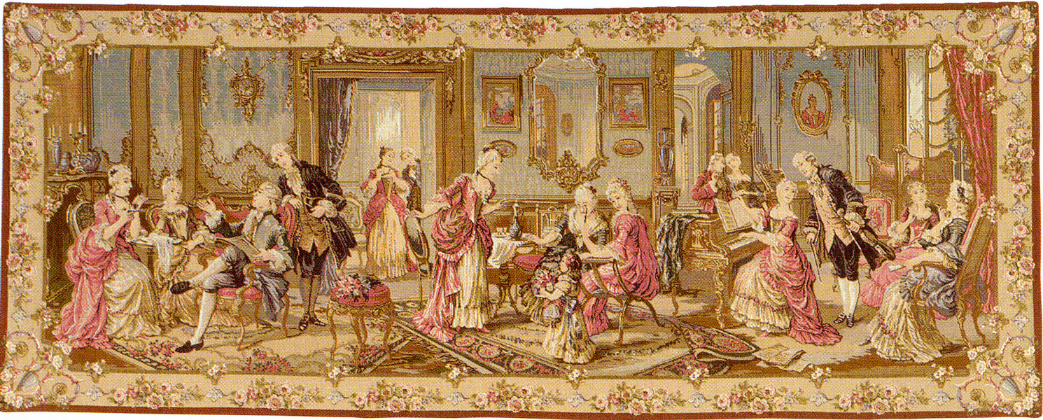
Social Significance of Salons
Salons were cosmopolitan in nature, a remarkable mixture of social classes were in attendance: aristocrats, distinguished foreigners, literati, artists, scientists, abbés, philosophes and, mostly importantly, women.
Common people could interact with the nobility at Parisian salons, thus salons helped to break down existing social and intellectual barriers.
Salons were places of enlightened conversation, which included an increased attention to gender equality. Salons offered an ideal location for women to expand their role in society.
*To learn more about the social structure of Paris salons, visit this link: https://sites.google.com/a/wisc.edu/ils202fall11/home/student-wikis/group4

Slide 8
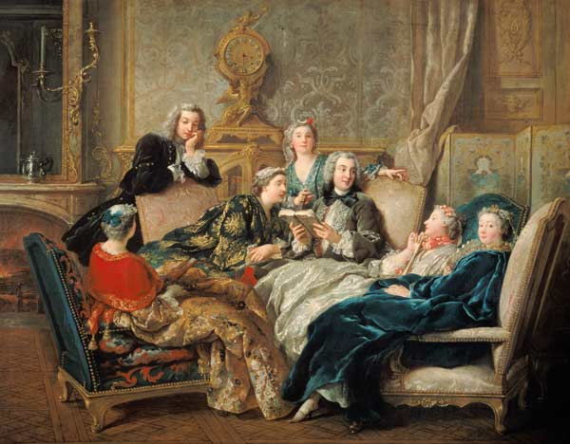
Cultural Significance of Salons
Salonnières established painters, writers, and composers as frequent guests at many of these Parisian gatherings, broadening the evening programs beyond intellectual discussion to include significant cultural contributions.
La Lecture de Molière (1728)
by Jean-François de Troy
*To learn more about cultural influences of the French Salons, visit this link: https://www.mtholyoke.edu/courses/rschwart/hist255-s01/paris_homework/Background.salon.html

Slide 9
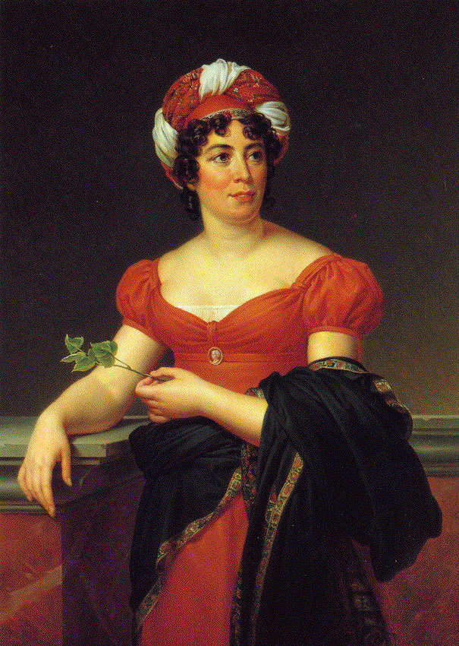
Political Significance of Salons
At first, salons gave women an opportunity to indirectly participate in political dialogue.
Later, Madame De Stael entertained philosophers who discussed and suggested revolutionary principles designed to alter the existing political regime.
"Conversation had become openly critical of the government, confrontational and conspiratorial, without, for all that, losing any of its gaiety, its verve or its elegance."
*To learn more about Mme De Stael, visit this link: http://digital.library.upenn.edu/women/eagle/congress/jenkins.html
or about the relationship of politics in the salons: http://www.nytimes.com/2005/11/20/books/review/20riding.html?_r=0

Slide 10
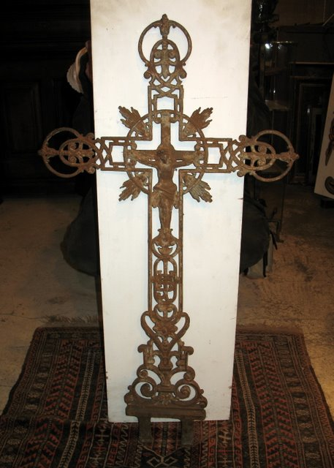
Religious Significance of Salons
The rapidly changing beliefs in the Catholic Church directly influenced much of the discussion that occurred in the salons during this period. As a result of the Enlightenment, many people no longer simply accepted religious doctrines, but began to analyze and question these teachings for themselves. The atmosphere in the salons allowed forums for discussion on important topics such as religion.
*To learn more about the Enlightenment and religion, visit this link: http://www.history.ac.uk/reviews/review/415
Late 18th century French Catholic
forged iron cross
crafted in the traditional Baroque style.

Slide 11
The Impact of the Salonnières
The 18th century Enlightenment inspired a focus on intellectual pursuits, which led to the establishment of the influential institution of the French salon. It was here that women found an opportunity to emerge as significant players in Paris society. Salons provided the perfect setting for the great minds of the period to gather and engage in challenging discourse on a variety of subjects. This exchange of ideas was hosted and overseen by the salonnières, who determined the agendas and guided the conversations. Here women could become more educated, interact with men, express their own thoughts, and impact the intellectual, political, cultural, and social environment and direction of France.

Slide 12
Works Cited
Jenkins, Helen P. “Madame de Stael.” A Celebration of Women Writers. The Congress of Women. 1893. WEB. 16 Mar 2014. <http://digital.library.upenn.edu/women/ eagle/congress/jenkins.html>.
“Salon Life.” 1815. Modern History Sourcebook. WEB. 8 Mar 2014. <http:// www.fordham.edu/ halsall/mod/18salons.asp>.
“The Salons of the Enlightenment.” Mount Holyoke. WEB. 10 Mar 2014. <https:// www.mtholyoke.edu/courses/rschwart/hist255-s01/paris_homework/ Enlightenment_salon.html>.
“Salons as a Woman’s Place.” Reinventing the Feminine. WEB. 16 Mar 2014.<http:// www.katelynludwig.com/masters/the_literary_salon/a_brief_history/ salons_as_womens_place.html>.
Zundel, Hannah. “Women's Involvement in the French Salons (Early 18th Century).” University of Wisconsin-Madison. Fall 2011. WEB. 10 Mar 2014. <https:// sites.google.com/a/wisc.edu/ils202fall11/home/student-wikis/group4>.

